Slide 1
‘Transition from A-level to university’ Saturday 15th June 2013
Barbara Hibbert
bhibbert@btopenworld.com

Slide 2
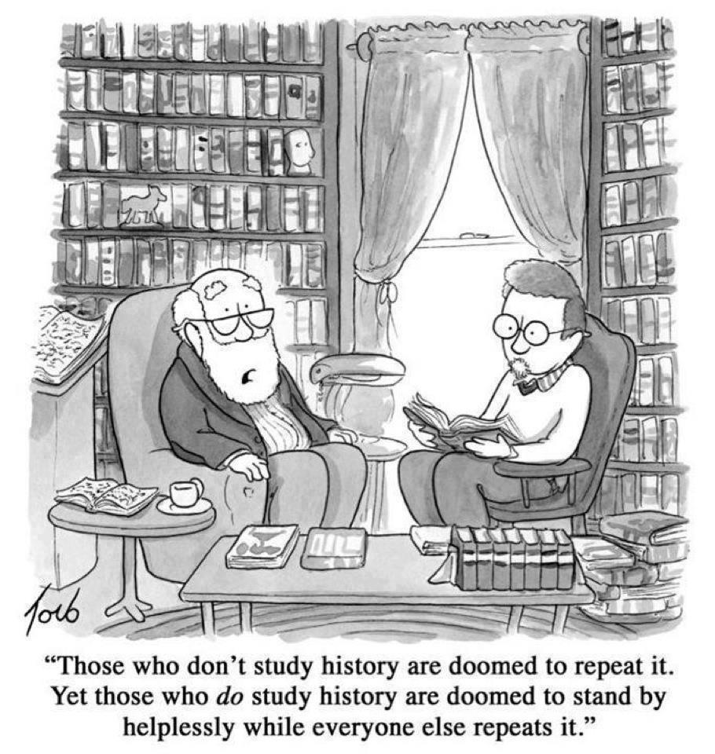

Slide 3
Where are we?
June 2013: consultation on reform of GCSEs
Sept 2013: first teaching of ‘strengthened’ GCSE history
Aug 2014: first results for linear GCSEs
Sept 2014: specifications for new GCSEs, A levels and AS with schools?
Sept 2015: first teaching of new GCSEs, new standalone AS, new linear A levels.

Slide 4
A level
A levels linear, taken over two years, exams at the end of the course
AS qualifications standalone, will not contribute to the full A level
First teaching September 2015 in ‘facilitating subjects’
First assessment summer 2017

Slide 5
Russell Group choice booklet: http://russellgroup.org/Informed%20Choices%20final.pdf

Slide 6
‘Facilitating subjects’ according to Russell Group
Russell Group – ‘facilitating subjects’
Maths and further maths
English literature
Biology
Chemistry
Geography
History
Languages (classic or modern)

Slide 7
Will universities ask for additional information?
Will universities ask for additional information?
Example of additional questions for applicants
1. With reference to your recent studies, discuss the questions that you needed to ask about the primary sources you used. (Answer with examples in no more than 500 words.)
2. For a history book of your choice, discuss how successfully the author deals with the issue of 'continuity and change'. (Answer in no more than 500 words.)

Slide 8
‘Modern History at Queen’s [Belfast] is ‘modern’ only in the sense that it does not cover the Ancient World. In fact it spans the period from the early middle ages to the twentieth century’.

Slide 9
How can you maximise your students’ chances?
How can teachers maximise students’ chances?
Recommend books/films/plays – model the ‘cultural capital’ they need
Enter them for competitions
Make contact with your local university
Look for ‘widening participation’ activities that your students can take part in

Slide 10
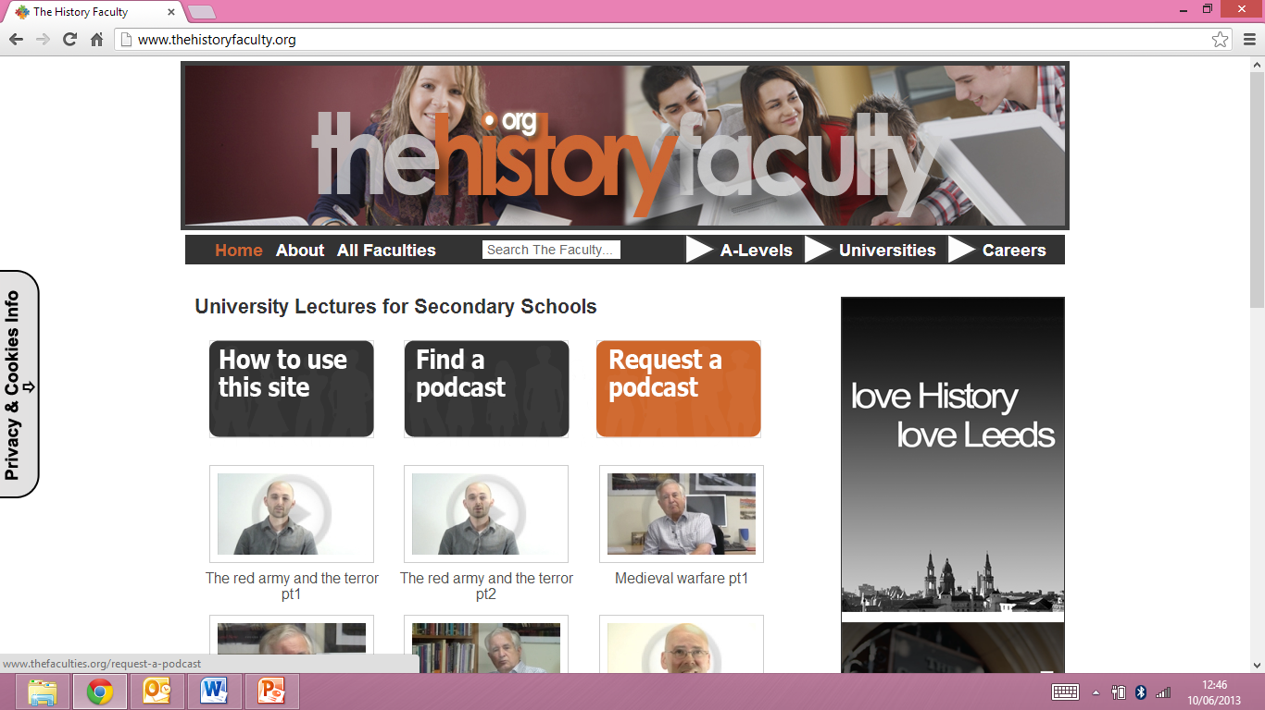

Slide 11
Sutton Trust summer schools: http://www.suttontrust.com/summer-schools/ The Sutton Trust was set up by Sir Peter Lampl to promote social mobility through education. It runs a series of summer schools at Durham, Cambridge, Imperial, Bristol, St Andrews and Nottingham. An example of a Sutton Trust summer school at Durham can be seen here: http://www.dur.ac.uk/sutton.trust/
Villiers Park Educational Trust: http://www.villierspark.org.uk/ runs masterclasses, online extension activities, and works with a number of universities on their widening participation programmes. It is based in Foxton, near Cambridge, but runs outreach programmes in various areas as well as online.
Debate Chamber: http://www.debatechamber.com/ runs summer schools and enrichment activities.
Historical Association ‘Great Debate’: The HA runs a biennial sixth form speaking competition. The 2012 competition was on ‘Why does History matter to you?’ and podcasts of the finalists can be heard here: http://www.history.org.uk/resources/general_resource_5320.html

Slide 12
Essay competitions
Essay competitions
Vellacott History essay prize run by Peterhouse College, Cambridge http://www.pet.cam.ac.uk/prospective-students/essay-prizes
The Robson Essay Prize is offered by Trinity College: http://www.trin.cam.ac.uk/index.php?pageid=680
The Julia Wood essay prize is offered by St Hugh’s College, Oxford http://www.st-hughs.ox.ac.uk/news-and-events/current/the-julia-wood-prize-2012 Students are sometimes able to enter a version of their personal study

Slide 14
Transitions between school and university in the study of History Barbara Hibbert May 2013 Higher Education Academy

