Slide 1
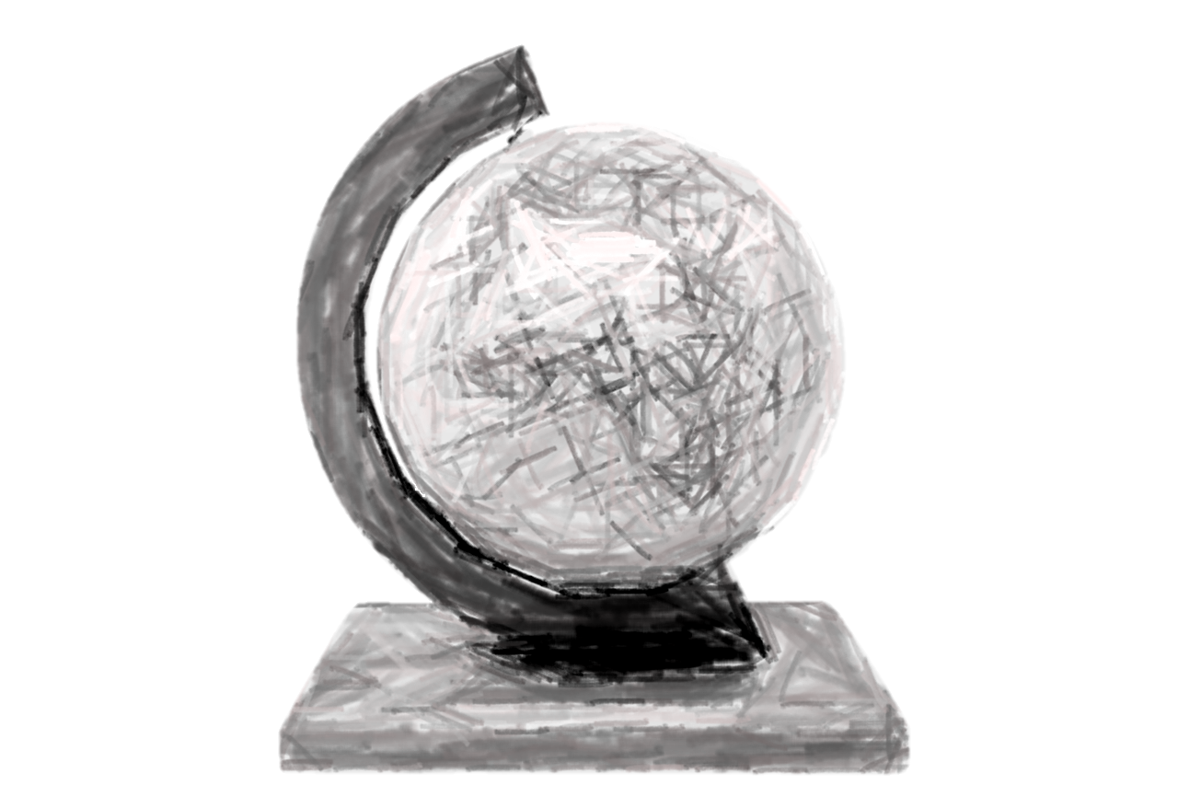
Oceanic Exchanges: Building a Transnational Understanding of Digitised Newspapers
M. H. Beals, Loughborough University https://orcid.org/0000-0002-2907-3313
www.mhbeals.com @mhbeals m.h.beals@lboro.ac.uk

Slide 2
Understanding Newspaper Digitisation
Why Digitize?
Increase the breadth of access
Make available to multiple local users at once
Make available to anyone with internet access
Decrease the need to use (fragile) originals
Make the text searchable
State of Michigan, "Guidelines for Digitizing a Newspaper“, 2012
www.mhbeals.com @mhbeals m.h.beals@lboro.ac.uk

Slide 3
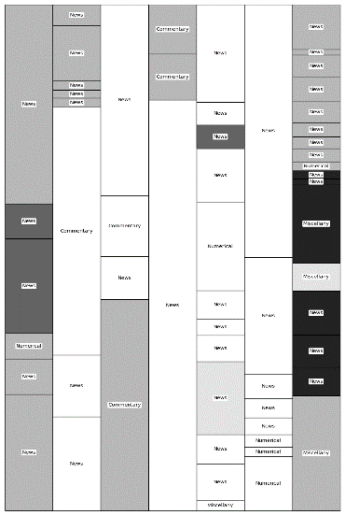
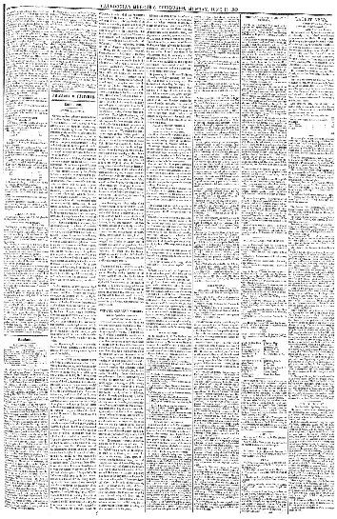
Contextualisation through Close Reading
The Caledonian Mercury 15 June 1840, Page 3
www.mhbeals.com @mhbeals m.h.beals@lboro.ac.uk

Slide 4
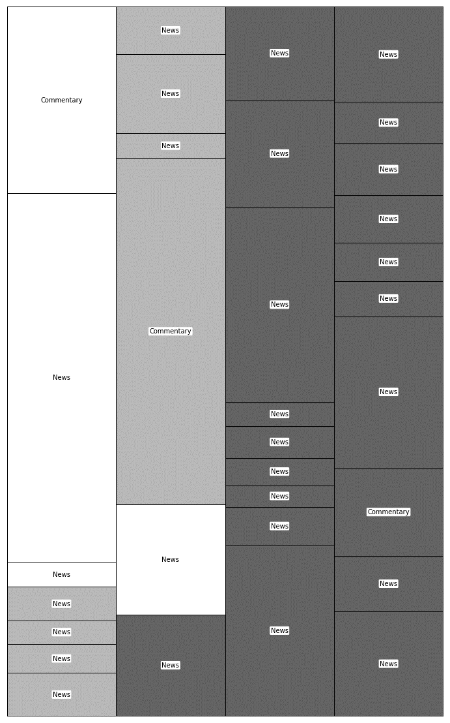
New Zealand Gazette and Wellington Spectator 7 September 1842, Page 3
www.mhbeals.com @mhbeals m.h.beals@lboro.ac.uk

Slide 5
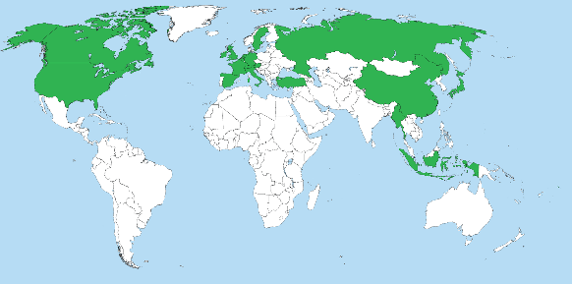
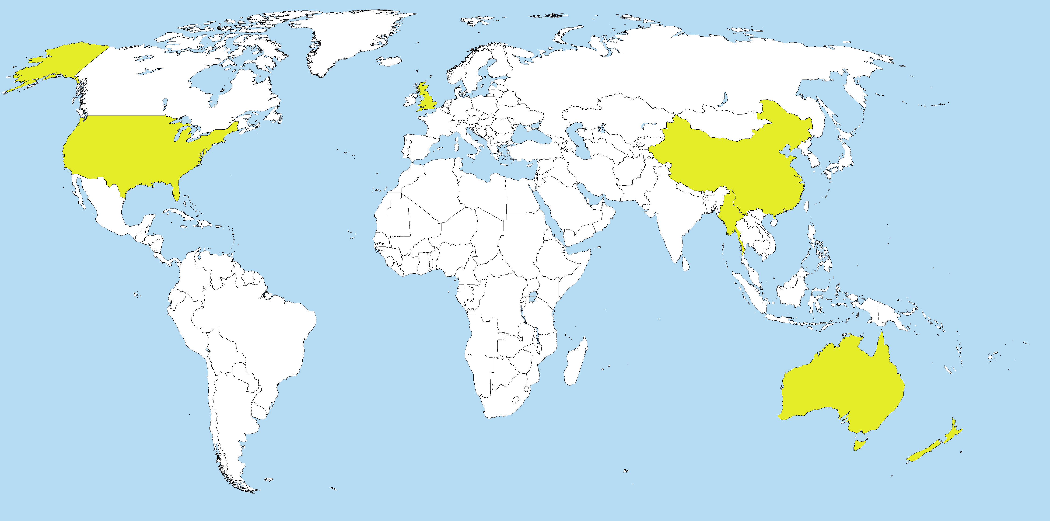
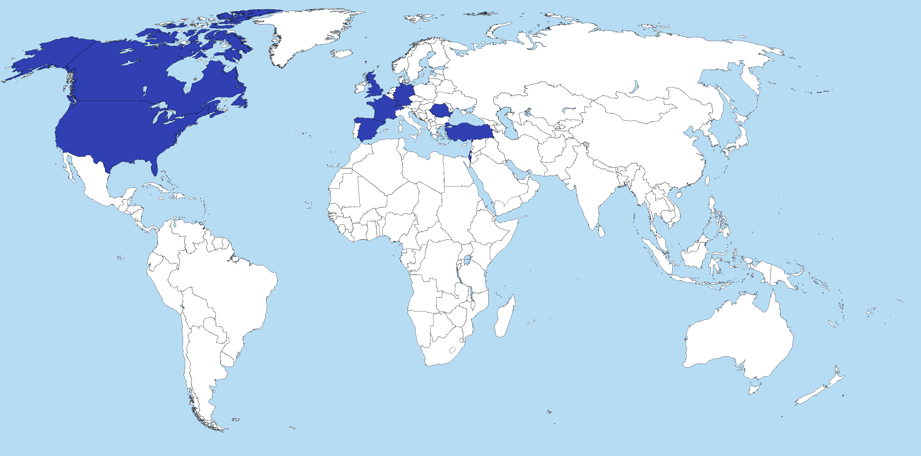

Slide 6
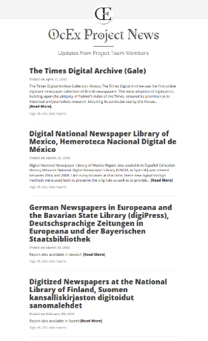
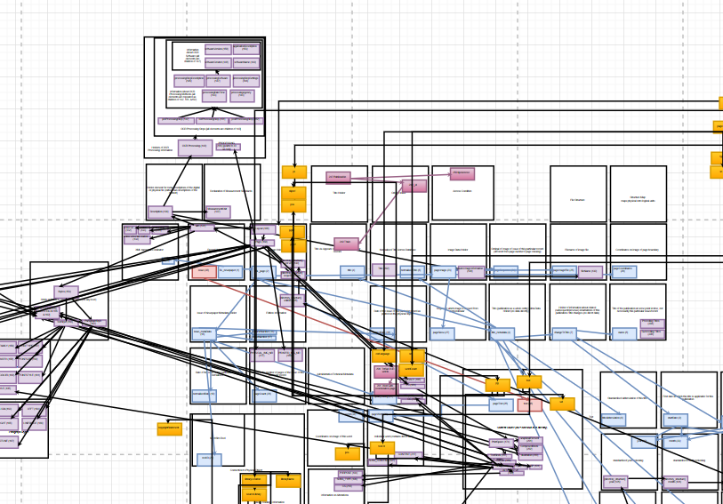
Mapping Metadata
www.mhbeals.com @mhbeals m.h.beals@lboro.ac.uk

Slide 7
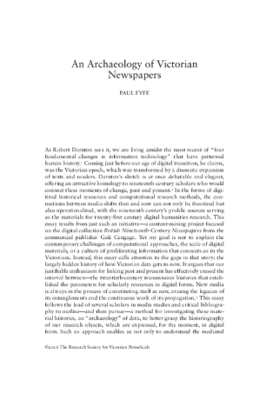
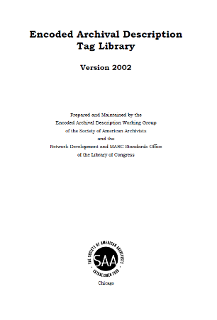
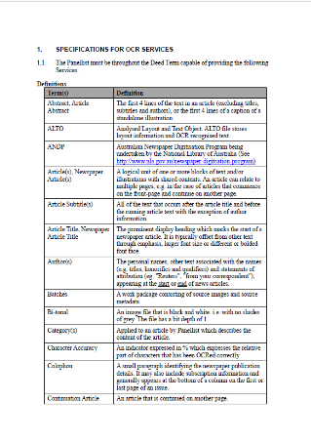
Archive Archaeology
www.mhbeals.com @mhbeals m.h.beals@lboro.ac.uk

Slide 8
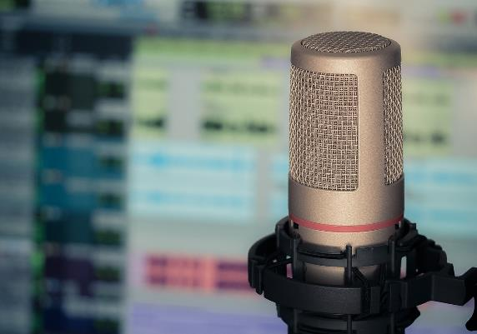
Oral Ontologies
Preservation and Access
Selection and Curation
Cultural and Institutional Policies
Metadata Practices
www.mhbeals.com @mhbeals m.h.beals@lboro.ac.uk

Slide 9
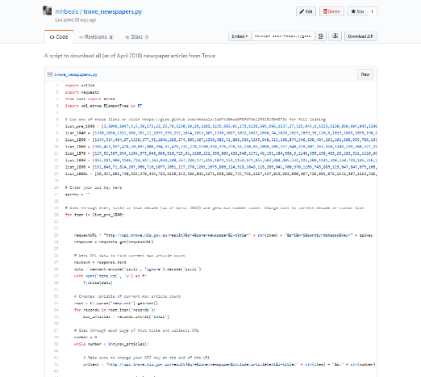
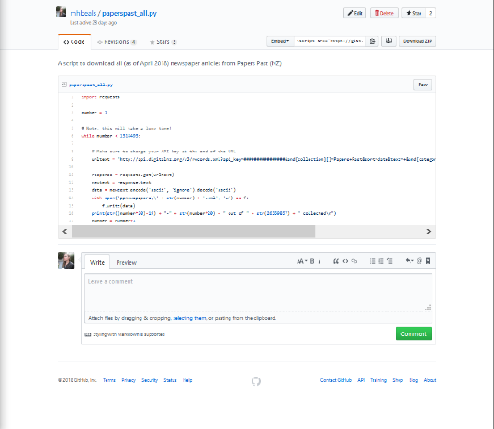
Building Bridges
www.mhbeals.com @mhbeals m.h.beals@lboro.ac.uk

Slide 10
www.mhbeals.com @mhbeals m.h.beals@lboro.ac.uk

Slide 11
Oceanic Exchanges: Building a Transnational Understanding of Digitised Newspapers
M. H. Beals, Loughborough University https://orcid.org/0000-0002-2907-3313
www.mhbeals.com @mhbeals m.h.beals@lboro.ac.uk

